Slide 1




Capstone project
Understanding Customer Responses to Marketing Campaigns
Prepared by Group 2
28 June, 2024

Slide 2


Team Members
Warun Kumar
Mukti Bhuyan Kuber
Member
Member

Slide 3


Introduction
Our project aims to provide valuable insights into the types of customers most likely to respond to specific marketing campaigns. These findings will help the retailer tailor their future marketing efforts more effectively, ultimately improving customer satisfaction and increasing sales.

Slide 4

Background

Slide 5


Background project
Current scenario:
Our client is a retail giant that serves customers across multiple countries with a diverse range of products. Recognizing the evolving market dynamics, they need to adapt their campaign strategies to maintain sales and enhance their competitive edge.

Slide 6
Objectives

Slide 7

Project Objectives
Strategy Development
Implementation Plan
Analysis Phase
Conduct a comprehensive analysis of current campaign performance, consumer demography, and behavior.
Identify strengths, weaknesses, opportunities, and threats (SWOT analysis) in the existing campaign results.
Brainstorm and identify the customer profile that is more likely to accept the campaign.
Develop a trend of customer spending behaviors to create targeted campaign strategies.
Create a model to learn the customer demography and spending behavior to determine customer’s campaign acceptance.
Test and then deploy the model to check customer’s campaign acceptance.

Slide 8


Expected Outcomes
Customer Profile:
Identify customer backgrounds who spend more.
Design targeted campaigns as per the customer’s background
Spending behavior:
Expand product line and strengthen brand presence as per spending behavior.
Design campaign strategies for most sold products.
Interface to identify campaign acceptance:
Foster stronger relationships with customers through targeted engagement strategies.
Increase customer retention rates and loyalty.

Slide 9
Methodology

Slide 10

Methodology
Exploratory Data Analysis | Brainstorming Sessions | Modeling and Deployment
Joining and Cleaning the collected data and perform thorough data integrity check. | Collaborate to generate customer profile to design more targeted campaigns. | Create various model and compare their performance to identify most suited model for the collected data.
Generate campaign performance and customer’s demography and spending behaviour to design targeted campaign stretagies. | Consider various product categories selling trends to expand the product line and design offers to run the capmaigns. | Train the model on balanced data and create an interface to check the customer’s campaign acceptance.

Slide 11
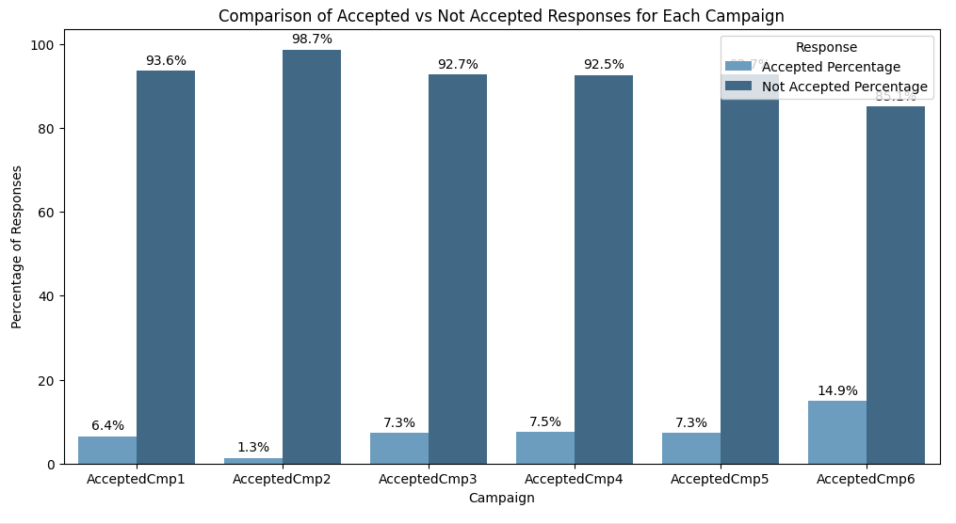
Campaign Performance Analysis
Dataset tenure: 1st Jan 2013 to 31st Dec 2014
In the current trend, the customer acceptance rate for various campaigns falls within a range of 2% to 15%.
Campaign 6's higher acceptance rate suggests it had a more compelling offer or better-targeted audience.

Slide 12
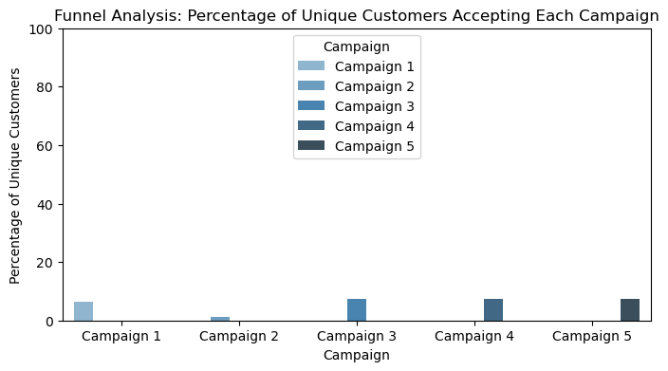

Funnel Analysis
Campaign Accept Percentage
Campaign 1 144 6.4
Campaign 2 30 1.3
Campaign 3 163 7.3
Campaign 4 167 7.5
Campaign 5 163 7.3

Slide 13
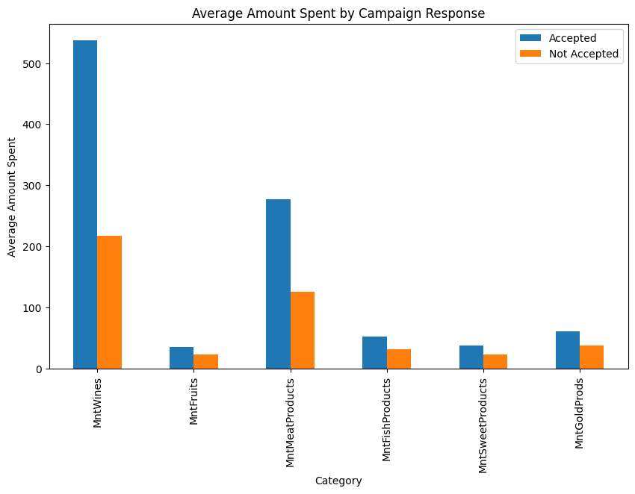
Behavior Impact on Campaign
Customers who accepted campaign offers tend to spend more across most product categories compared to those who did not accept.
The most significant differences in spending are observed in the categories of wines and meat products.
Pearson correlation: 0.4892112144220273, p-value: 3.9538783211580286e-135
There is a statistically significant correlation between the amount spent on wines and the number of campaigns accepted.

Slide 14
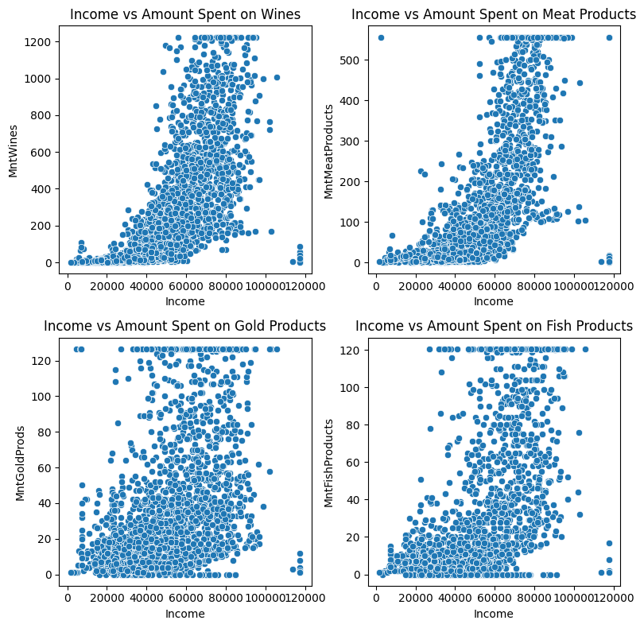
Income Impact on amount spent
Correlation between Income and MntWines: 0.71
Correlation between Income and MntMeatProducts: 0.74
Correlation between Income and MntGoldProds: 0.44
Correlation between Income and MntFishProducts: 0.58
Wines and Meat Products: These categories show a strong correlation with income, indicating that marketing strategies focusing on higher-income customers for these products may yield better results.

Slide 15
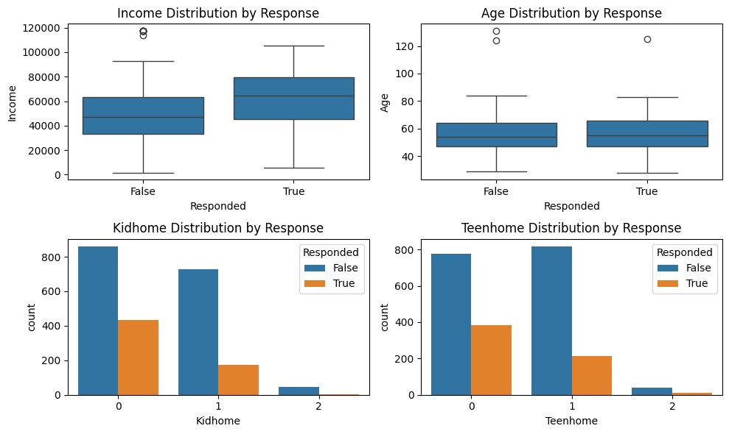
Customer profiling
Customers more likely to respond to the campaign:
Higher income customers tend to respond more to campaigns.
The presence of children or teenagers at home tends to lower the response rate.
The age distribution suggests that middle-aged customers are more likely to respond, with older and younger customers showing less engagement.

Slide 16
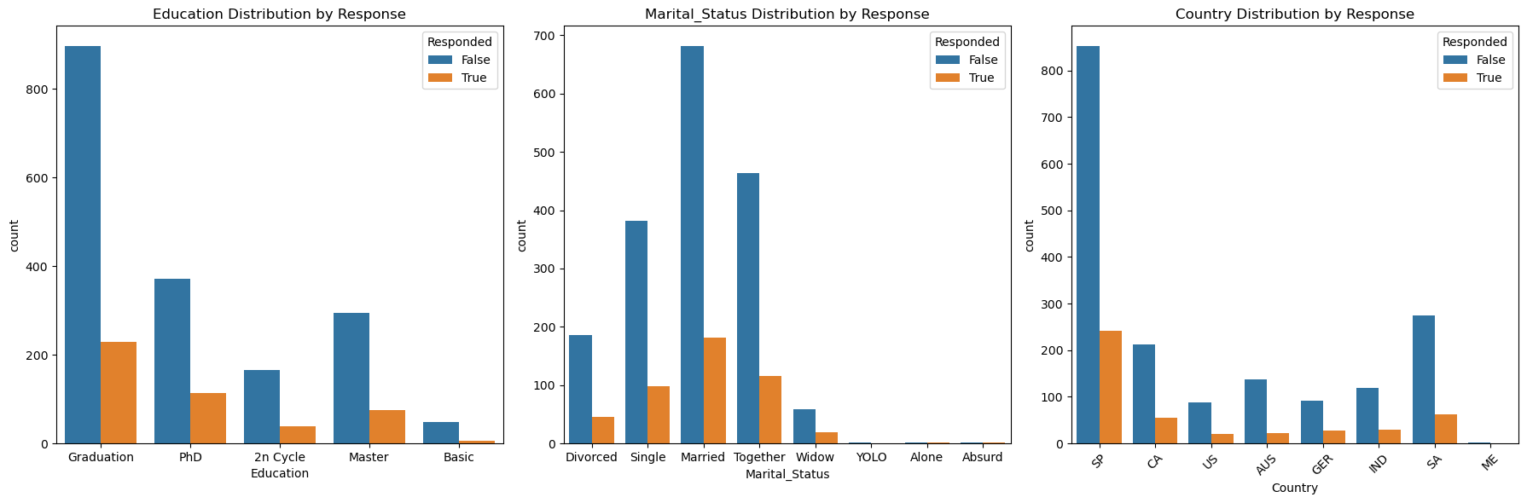
Customer profiling
Customer with higher education tends to respond more to the campaigns.
Married, Together, and Single people tend to respond more to the campaigns.
The campaign seemed to have a higher yield in Spain than any other country.

Slide 17
Customer profiling
Do recent customers complain less in general compared to older customers?
Customer_Type
Older 0.010714
Recent 0.008036
Chi-Square Statistic: 0.19227880426618596, P-Value: 0.6610267177005811
Result: There is no significant difference in complaint rates between recent and older customers.
Do people who accept the offer in the first campaign also participate in another campaign?
The proportion of customers who accepted the first campaign and also accepted the second campaign: 0.09
The proportion of customers who accepted the first campaign and also accepted the third campaign: 0.17
The proportion of customers who accepted the first campaign and also accepted the fourth campaign: 0.33
The proportion of customers who accepted the first campaign and also accepted the fifth campaign: 0.47
The proportion of customers who accepted the first campaign and also accepted any other campaign: 0.64
Result: The proportion of customers who accepted the first campaign and also accepted each of the other campaigns.

Slide 18
Business Recommendation
Target High-Spending Customers: Tailor offers that cater specifically to their preferences, especially in high-expenditure categories like wines and meat products.
Leverage Significant Product Categories: Develop targeted marketing campaigns that emphasize wines and meat products.
Focus on Higher-Income Customers: Direct marketing efforts toward higher-income customers, as they are more likely to spend on these categories.
Demographic-Based Targeting: Segment your customer base by education level, marital status, and age. Create personalized campaigns that resonate with middle-aged, higher-educated individuals. Additionally, consider targeting households without children or teenagers.

Slide 19
Geographic Targeting: Prioritize marketing efforts in Spain. Consider launching country-specific campaigns that cater to cultural preferences and purchasing behaviors. Analyze regional data to identify further opportunities for geographic targeting.
Enhance Campaign Offers: Structure campaign offers to highlight and promote wines, as this product category significantly influences campaign acceptance. Bundle wine offers with other popular products to increase overall engagement.
Monitor and Adjust Campaign Strategies: Continuously monitor campaign performance metrics. Conduct A/B testing to experiment with different offers, messages, and delivery times to identify the most effective strategies. Adjust campaigns based on customer feedback and performance data.

Slide 20
Modeling

Slide 21
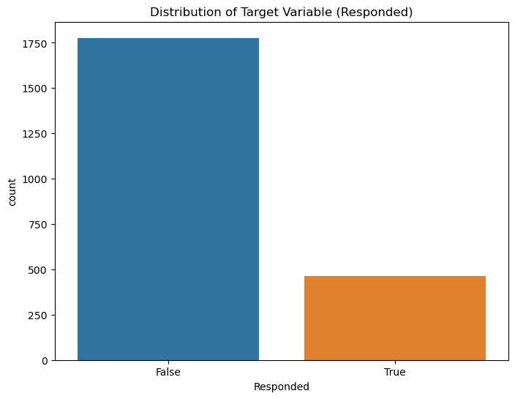
Checking Imbalace
Why Class Imbalance is an issue:
Bias Towards Majority Class.
Skewed Performance Metrics.
Poor Recall for Minority Class

Slide 22
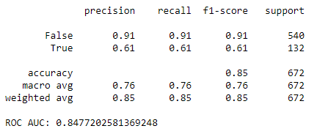
Training & Modeling
SMOTE
Use SMOTE to oversample the minority class and RandomUnderSampler to undersample the majority class.
Training and evaluating models

Slide 23
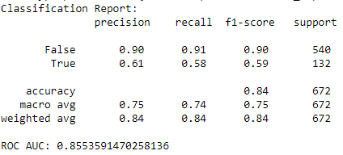
Regularization and Hyperparameter Tuning
Cross-Validation
Cross-Validation Scores: [0.96977439 0.97764301 0.98540551 0.9696193 0.97462669]
Mean CV Score: 0.9754137808329707

Slide 24
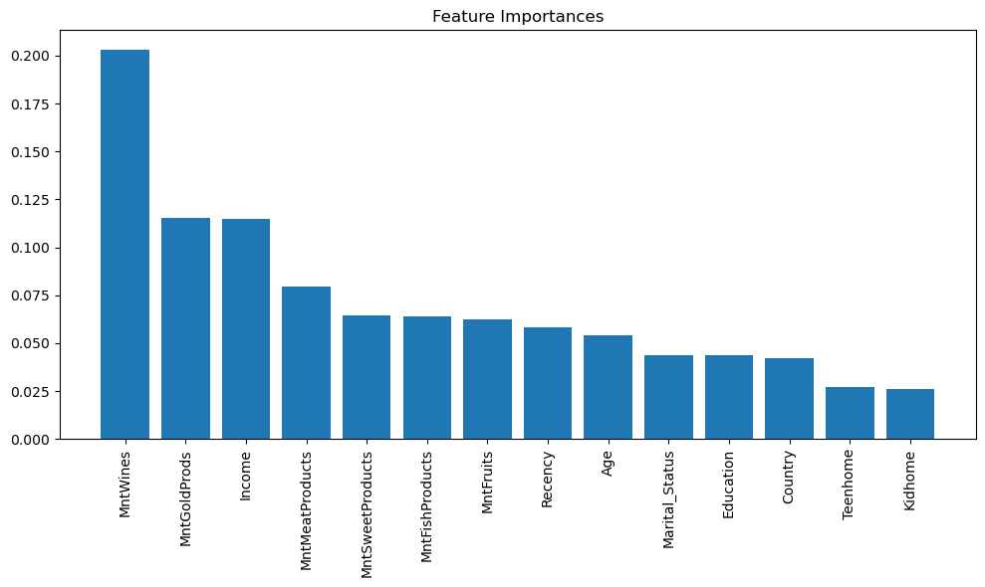
feature importance

Slide 25
Deployment

Slide 26
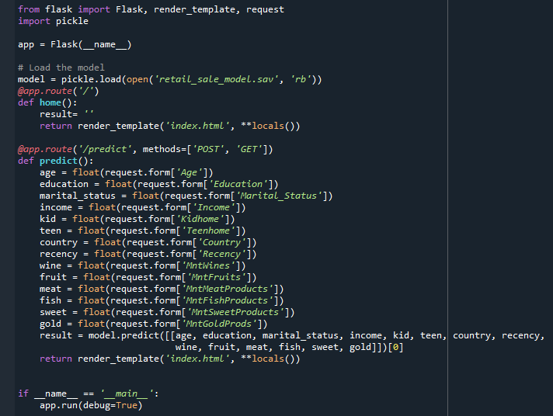
Deploy.py

Slide 27
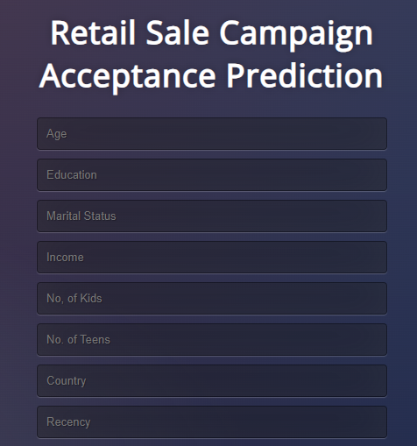
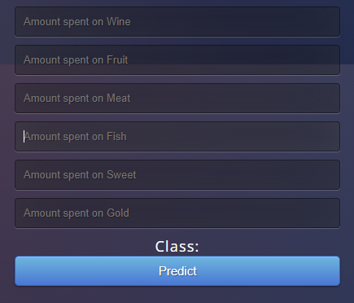
Campaign Prediction

Slide 28
Conclusion
By implementing a well-researched and innovative campaign strategy, our goal is not only to boost immediate campaign response but also to establish a sustainable framework for continued growth and success.

Slide 29
THANK YOU

